Slide 1

Chapter 1
Introduction
Copyright © The McGraw-Hill Companies, Inc. Permission required for reproduction or display.

Slide 2
1-1 DATA COMMUNICATIONS
The term telecommunication means communication at a distance. The word data refers to information presented in whatever form is agreed upon by the parties creating and using the data. Data communications are the exchange of data between two devices via some form of transmission medium such as a wire cable.
Topics discussed in this section:
Components of a data communications system
Data Flow

Slide 3
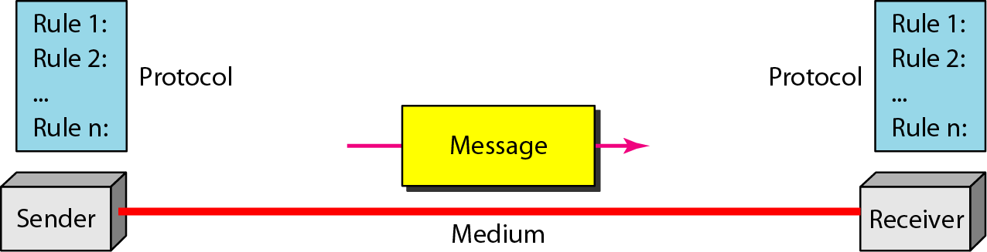
Figure 1.1 Components of a data communication system

Slide 4
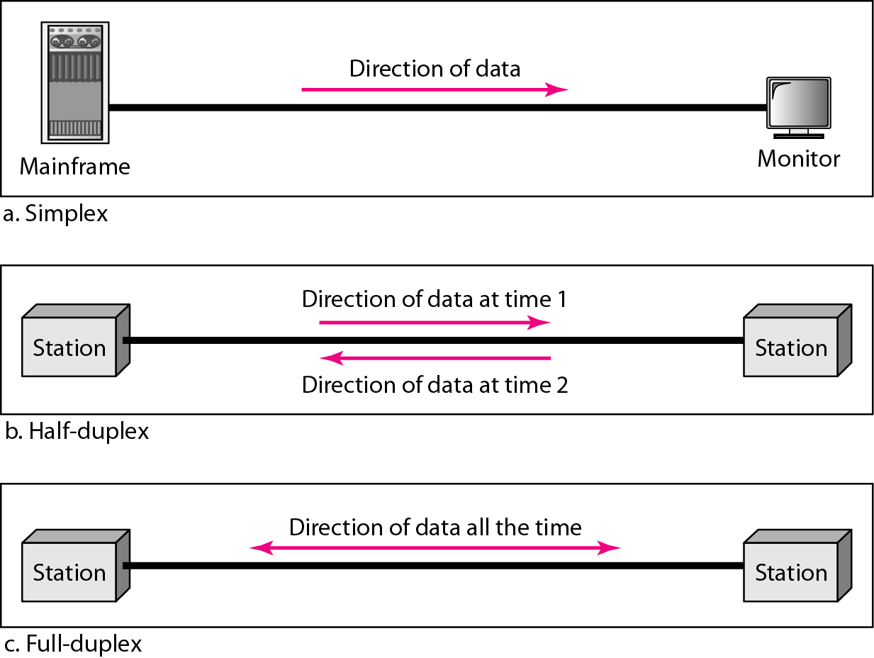
Figure 1.2 Data flow (simplex, half-duplex, and full-duplex)

Slide 5
1-2 NETWORKS
A network is a set of devices (often referred to as nodes) connected by communication links. A node can be a computer, printer, or any other device capable of sending and/or receiving data generated by other nodes on the network. A link can be a cable, air, optical fiber, or any medium which can transport a signal carrying information.
Topics discussed in this section:
Network Criteria
Physical Structures
Categories of Networks

Slide 6
Network Criteria
Performance
Depends on Network Elements
Measured in terms of Delay and Throughput
Reliability
Failure rate of network components
Measured in terms of availability/robustness
Security
Data protection against corruption/loss of data due to:
Errors
Malicious users

Slide 7
Physical Structures
Type of Connection
Point to Point - single transmitter and receiver
Multipoint - multiple recipients of single transmission
Physical Topology
Connection of devices
Type of transmission - unicast, mulitcast, broadcast

Slide 8
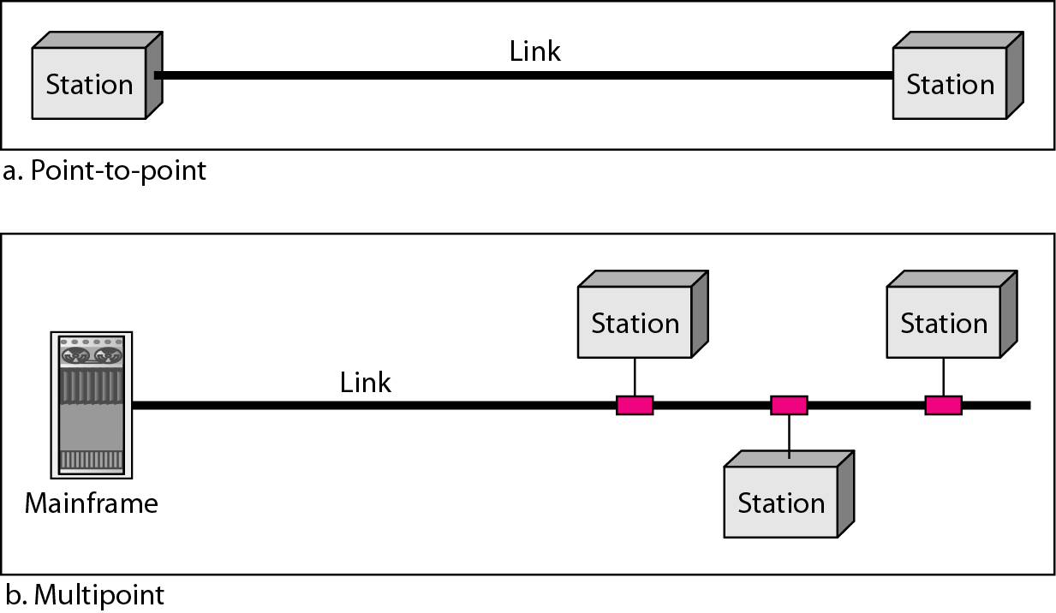
Figure 1.3 Types of connections: point-to-point and multipoint

Slide 9
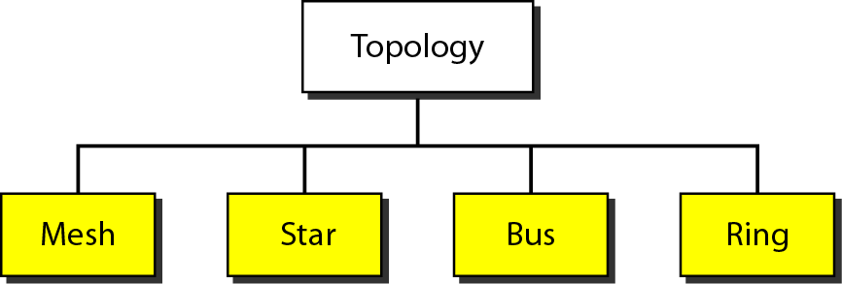
Figure 1.4 Categories of topology

Slide 10
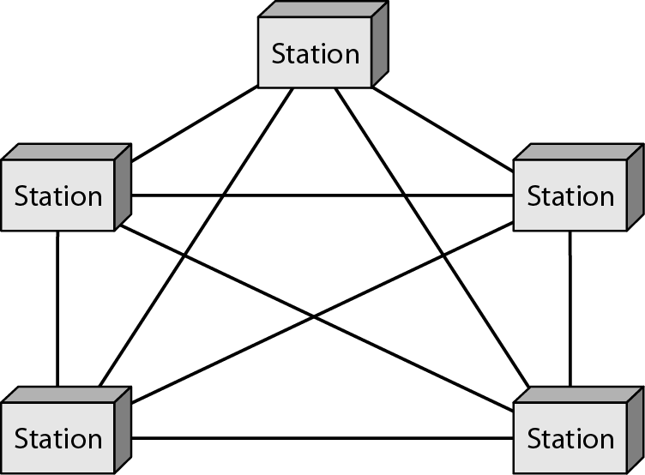
Figure 1.5 A fully connected mesh topology (five devices)

Slide 11
Mesh Topology, all the computers are connected to each other in a network. It is very difficult to establish the connections of the mesh topology. In a Mesh topology every computer has a point-to-point connection to the other computer.
In order to connect n nodes, mesh topology require n(n-1)/2 communication links. Communication link can be twisted pair, co-axial cable or optical fiber
Characteristics of Mesh Topology:
Fully connected
Robust
Not flexible
Poor expand-ability

Slide 12
Advantages:
No traffic problem as there are dedicated links for each computer.
It has multiple links, so if one route is blocked then other can be accessed for data communication.
It provides high privacy and security.
Due to point-to-point links, fault identification is easy
Disadvantages:
It requires high number of cabling and I/o ports for the communication.
Installation is very complex in mesh topology, as each node is connected to every node.
It is costly compared to the other network topologies.

Slide 13
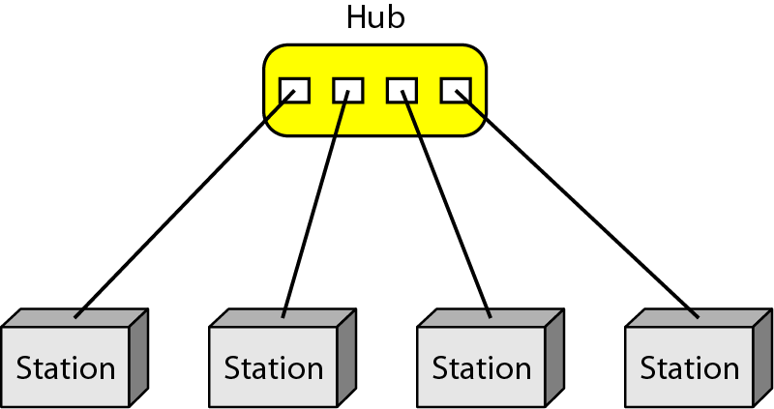
Figure 1.6 A star topology connecting four stations

Slide 14
Start Topology, all the computers (nodes) go to the central location having a device called as hub. All the devices on the network are connected with a hub device through a link. Each device requires a single wire for the connection to the hub.
In star Topology, there exists a point-to-point connection between a node and hub. The hub takes a signal from any node and passes it along to all the other nodes in the network. The hub controls and manages entire function of the network.
Characteristics of Star Topology:
High Speed
Very Flexible
High Reliability

Slide 15
Advantage:
Easy to manage because each node require separate cable.
Easy to locate problems because cable failure only affect a single user.
Easy to expand without disturbing to the network
Due to Hub device network management is much easier.
Fault identification is easy, also it is easy to remove nodes
Star topology provides very High speeds of data transfer.
Disadvantages:
If the hub device goes down, the entire network will be dead.
Star topology requires more wires compared to the ring and bus topology.
Whole performance of the network depends on the hub.

Slide 16
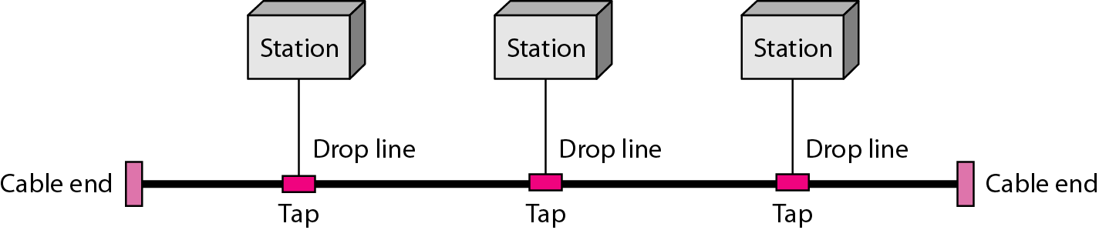
Figure 1.7 A bus topology connecting three stations

Slide 17
A bus topology consists of a single cable with the terminator at each end. All available devices are connected to the single cable. One single cable acts as the backbone for the whole network.
Characteristics of Bus Topology:
Flexible
Expandable
Moderate Reliability
Moderate performance

Slide 18
Advantage:
Easy to connect or remove nodes in a network without affecting any other node.
In case of any node failure, there will be no effect on other nodes or network.
Cable cost is less as compared to other network topologies (mesh and star).
It is easy to understand topology.
Easy to expand by joining two cable
Disadvantage:
In case of any node failure it is difficult to find faults in a network.
If the backbone cable damages the entire network will fail.
If network traffic increases or nodes increases, the performance of network decreases.
The length of cable is limited

Slide 19
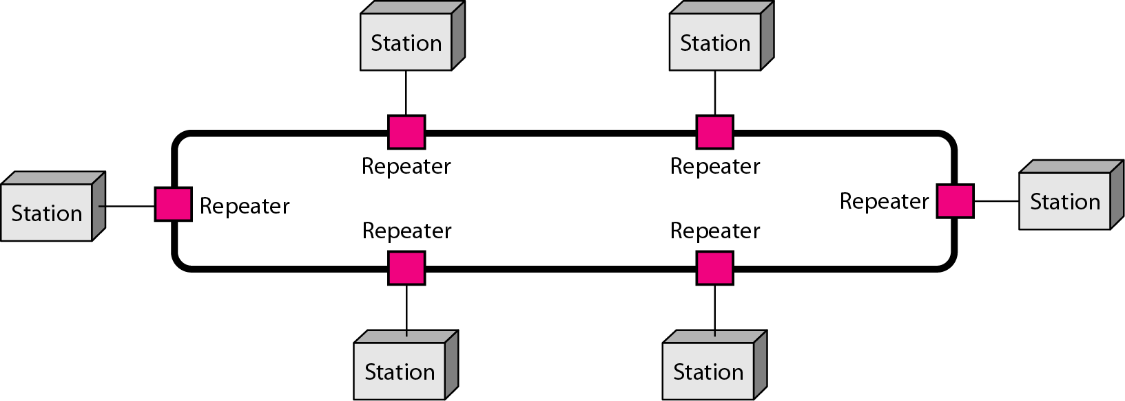
Figure 1.8 A ring topology connecting six stations

Slide 20
In Ring Topology, each computer or node is connected with its neighboring computer forming the shape of ring hence it is known as Ring Topology.
In ring topology the data travels in a circular fashion from one computer to another (clockwise or counter clockwise). In case of any failure in a cable or device break the circular loop and can take down the entire network.

Slide 21
Advantages:
Data flow is in circular direction which reduces the chance of packet collision.
The maintenance of ring network is much easier compared to the bus topology.
It provides good communication over a long distance.
It can handle high volume of nodes in a network.
It is less costly compared to the mesh, tree, and hybrid topology.
Troubleshooting is much easier because cable faults can be located easily in ring topology.
Disadvantage:
A single break in the cable can cause a disturbance in the entire network
Addition and removal of any node in a network is difficult and can cause issue in network activity.
It is much slower than Ethernet network under normal load conditions.

Slide 22
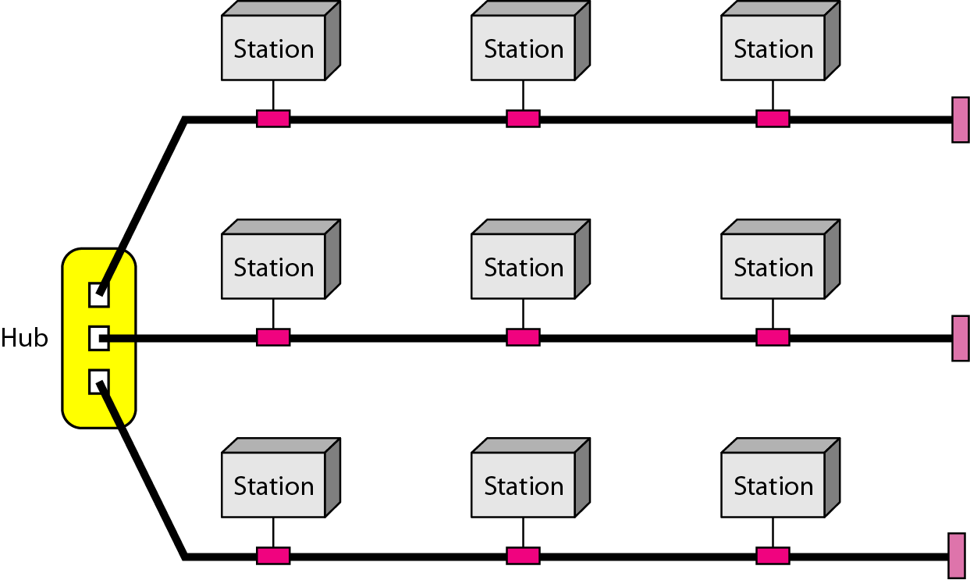
Figure 1.9 A hybrid topology: a star backbone with three bus networks

Slide 23
Hybrid topology is the combination of more than two topologies. In a computer networking, a network structure that contains more than two topologies is known as hybrid topology. It inherits the advantages and disadvantages of included topologies.
Hybrid topology include a mix of bus topology, mesh topology, ring topology, star topology, and tree topology. The combination of topology depends on the requirement of organization.

Slide 24
Advantages:
Hybrid topology Combines the benefits of different types of topologies
Can be modified as per requirement
It is extremely flexible.
It is very reliable.
It is easily scalable
Disadvantages:
It is expensive
The design of hybrid topology is complex.
Hardware changes are required in order to connect one topology to another topology.

Slide 25
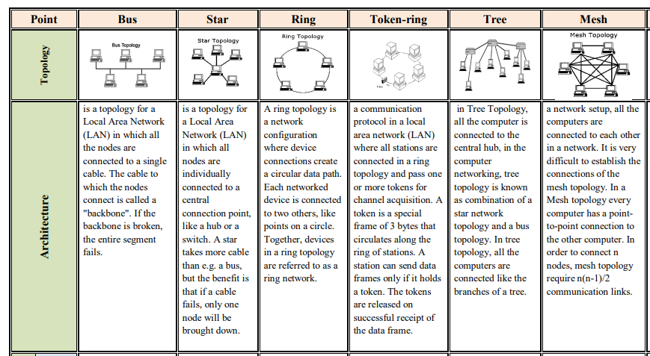

Slide 26
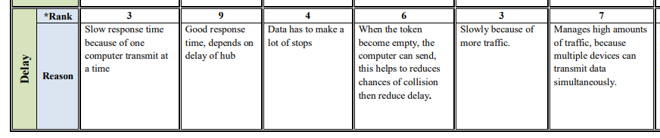

Slide 27
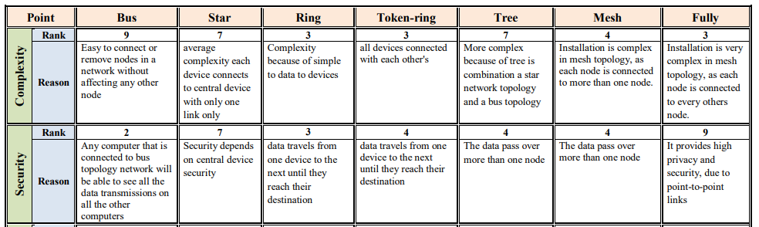

Slide 28
Categories of Networks
Local Area Networks (LANs)
Short distances
Designed to provide local interconnectivity
Wide Area Networks (WANs)
Long distances
Provide connectivity over large areas
Metropolitan Area Networks (MANs)
Provide connectivity over areas such as a city, a campus

Slide 29
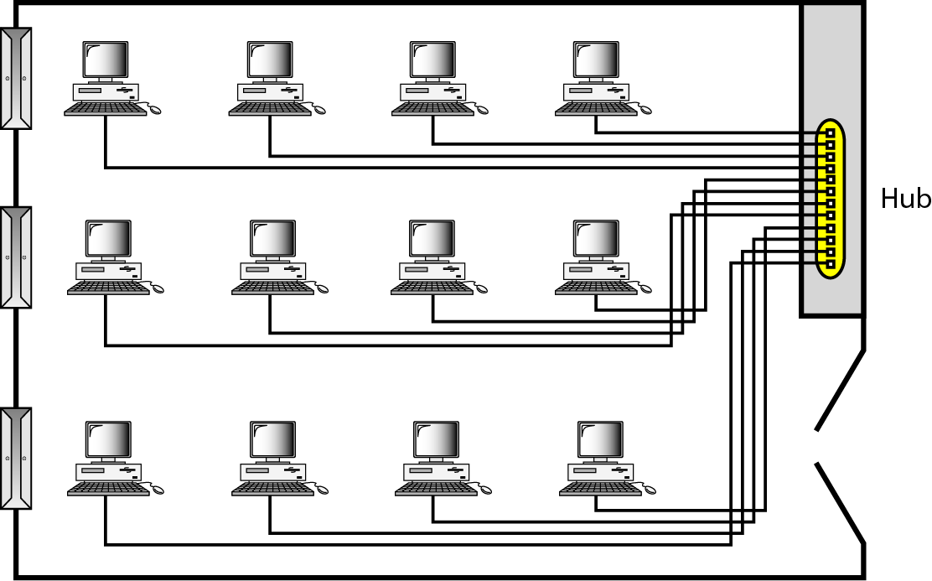
Figure 1.10 An isolated LAN connecting 12 computers to a hub

Slide 30
LAN
The full form of LAN is the ‘Local Area Network. ‘ As the name suggests, it connects the computers by covering the local area within 10m to 1.5 km. Since it covers a small local area, you will find LAN in local places like offices, colleges, schools, groups of buildings, business organizations.

Slide 31
Features of LAN:
The network capacity of a LAN is limited to a single room and small geographical areas like homes, small firms, and offices.
The LAN has the advantage of high speed for data transfer.
File transfer and recovery are more manageable in a LAN network because backup files are stored in a server.
It has no connection with the external system, which ensures privacy.
The LAN network is a private network, it doesn’t own by any government bodies.
The network ranges from 1m to 1.5km.

Slide 32
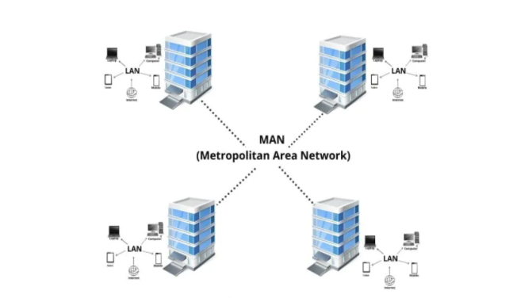
MAN

Slide 33
The Full form of MAN is the ‘Metropolitan Area Network.’ The WAN is a superior version of the LAN network, often used in cities and other locations covering a range of 5-60 km to transfer data at high speed.

Slide 34
Features of MAN:
The network coverage of MAN is more massive than LAN but smaller than WAN.
It is bounded in large geographical areas such as a town, city.
The data transmission speed is moderate.
Its ownership can be public or private parties.
The network ranges from 5 to 60km.

Slide 35
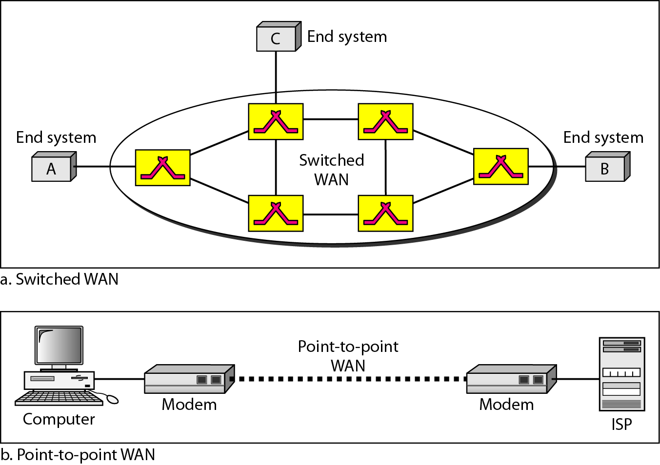
Figure 1.11 WANs: a switched WAN and a point-to-point WAN

Slide 36
WAN
A WAN full-form is ‘Wide Area Network. ‘ A WAN is used to connect computers that are not close to one another. It is the collection of many LANs with a much more extensive range than LAN and MAN.
In LAN, WAN, and MAN, the WAN network’s geographical periphery is more widespread such as a network of systems spread across the entire city, country, or even continent.

Slide 37
Features of WAN:
It is generally used for voice and data for mobile and landline phone applications.
A large number of people can communicate with one another in this single network.
Its data transmission speed fluctuating sometimes slow or even very fast.
The network range or coverage area of ​​a WAN is more massive, from which we can transfer the data across the world.

Slide 38
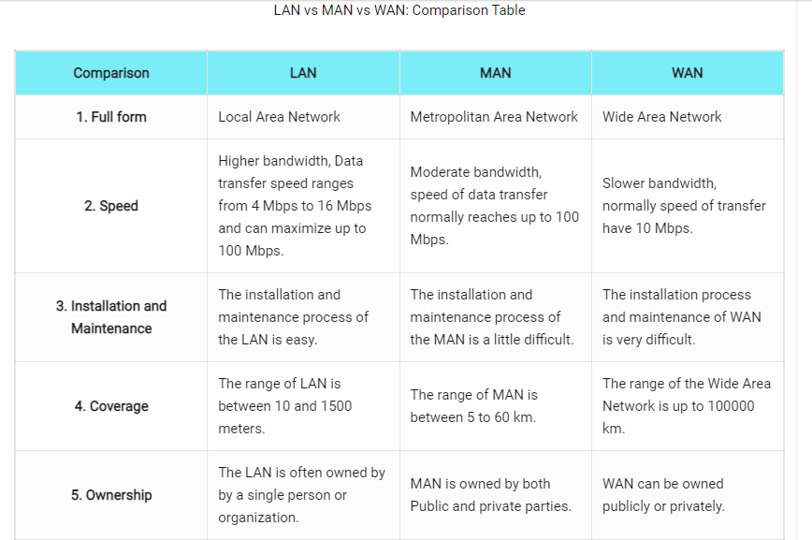

Slide 39
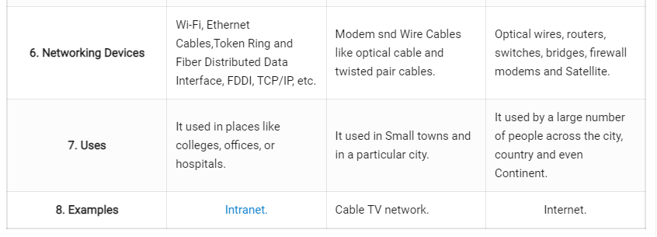

Slide 40
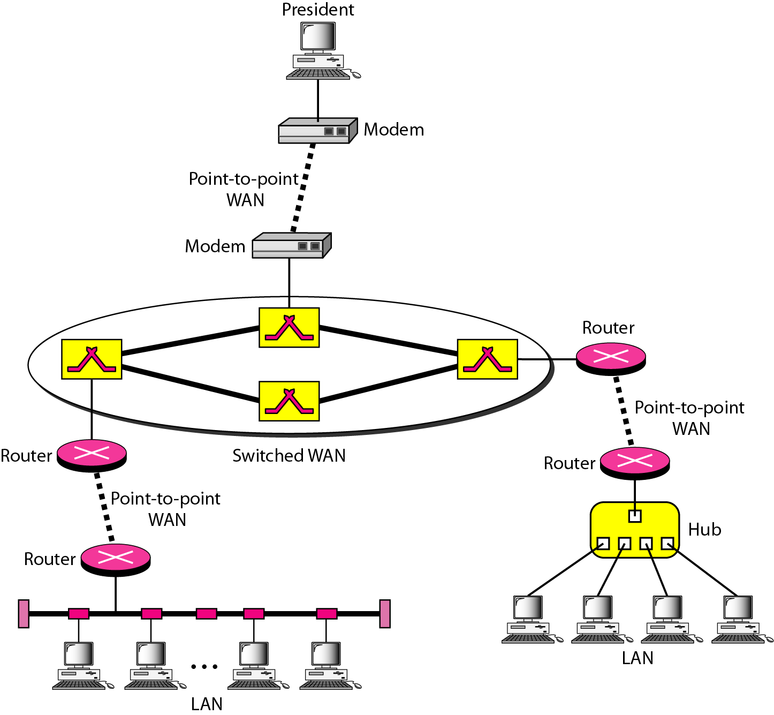
Figure 1.12 A heterogeneous network made of four WANs and two LANs

Slide 41
1-3 THE INTERNET
The Internet has revolutionized many aspects of our daily lives. It has affected the way we do business as well as the way we spend our leisure time. The Internet is a communication system that has brought a wealth of information to our fingertips and organized it for our use.
Topics discussed in this section:
Organization of the Internet
Internet Service Providers (ISPs)

